Slide 1






Used Cooking Oils:
a social value for your territory
Michel MILLARES – Gecco
michel.millares@gecco.fr
Gecco
@GeccoSARL
Notes:
*

Slide 2

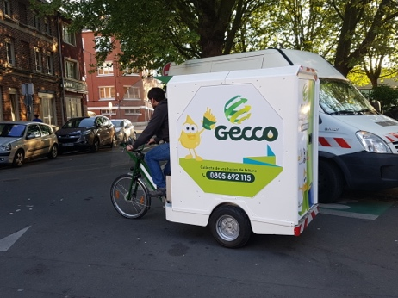
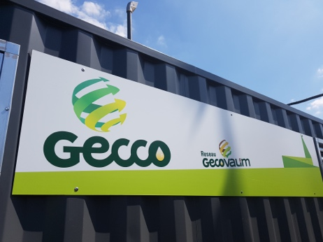
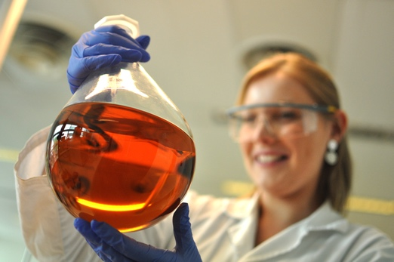
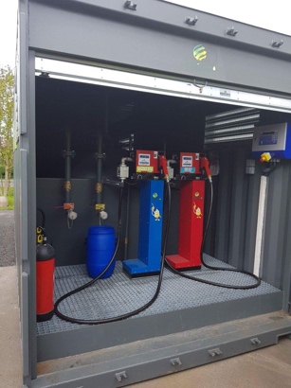

What about us ?
Social company – Lille (France)
Creation: 2007
Staff : 10
Turnover 2017: 915 k€
UCO and Food waste collection
Valorisation in circular economy loops
Notes:
*

Slide 3
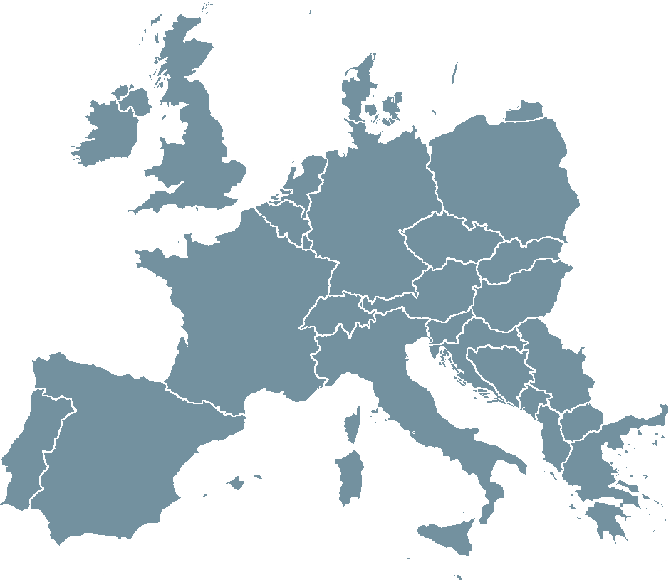



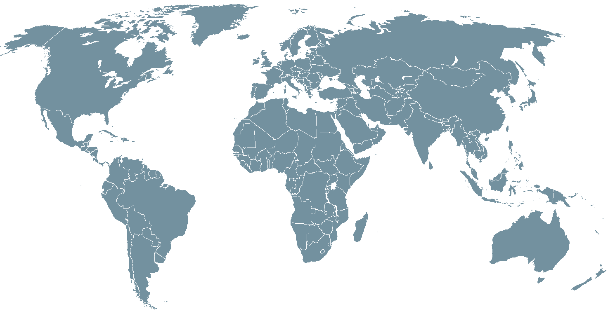


















UCO’s present situation
UCO collection
UCO production
Notes:
*

Slide 4




The paradox at territorial level
Imports Fuel
Exports its UCO
Produces UCO
For public service
Notes:
*

Slide 5





Our proposition
UCO collection
Esterification in local plant
Enzymatic process
X10 Local jobs
Professional insertion
100% renewable biodiesel
- 80% fossil energy
No toxics
- 93% GHG
- 97% air pollution
- 43% particles
Use in local public services vehicles
UCO production
Local circular economy
Energetic autonomy
No fleet investment
Notes:
*

Slide 6




BIOHEC-LIFE PROJECT - Partners
Project coordinator
Social company
Lille (F)
Staff : 10
Catering waste collection and valorisation
Public laboratory
Lille 1 University
(F)
Staff : 81
Biotechnology and eco-designed process development
Association
Brussels (B)
Staff : 9
Independent European think & do tank
Association
Brussels (B)
Staff : 4
Conception an realisation of waste recycling processes
Cofunded by the European Union
LIFE15-CCM_FR_000068
Notes:
*

Slide 7

BIOHEC-LIFE Project’s objectives
Eco-designed biodiesel production unit
Improving general public’s UCO collection up to
0,1 kg/year/hab
Ethyl Ester Biodiesel produced 100% from waste without toxic chemicals
Test with public services vehicles fleet
Notes:
*

Slide 8

BIOHEC-LIFE Project’s objectives
Life-cycle results vs gas-oil :
- 93 % CO₂ emissions
- 86% NRE consumption
- 97% ozone pollution
- 46% water pollution
- 98% toxics
Partnership research for european level commercial replication
Notes:
*

Slide 9








LILLE, a commited City
energy
service
2004
2009
2014
2017
2018
2019
Covenant
of mayors
-19% GHG
-19% energy use
9 millions € yearly bill
40% renewable energy coverage
Notes:
Stéphane

Slide 10
Partnership with the City of Lille
Objectives for Gecco
Objectives for the City of Lille
Upscaling biodiesel production process
Obtaining regulatory authorization for commercial production
Getting technically prepared to supply future customers
Preparing commercial relationships with public service fleets
In the context of its climate, air an energy policy :
Increasing the coverage of its needs in renewable energies
Improving the city’s air quality
Cost optimization (fuel + investments)
Supporting an innovative approach developed on its territory
Contractual basis
Innovation partnership contract
Extension of test fleet when technical objectives are completed
Financial participation on a part of biofuel’s cost
Notes:
Michel et Stéphane
*

Slide 11
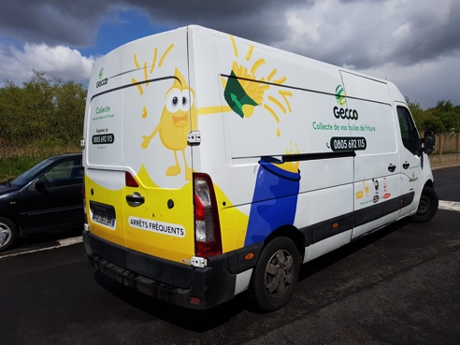
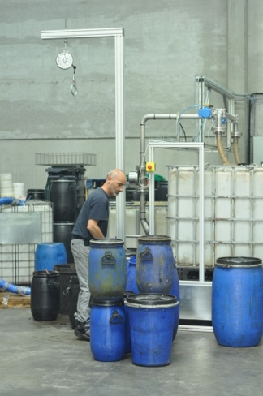

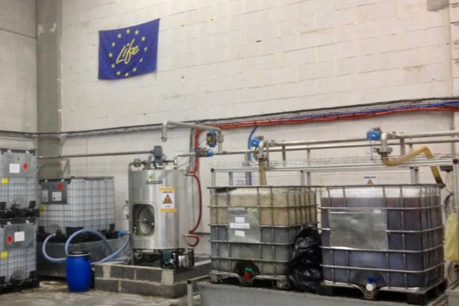


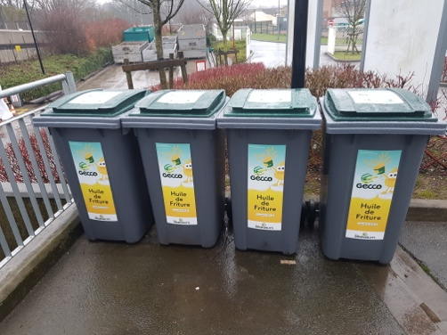

UCO Collection and processing
Notes:
Stéphane puis Michel
*

Slide 12
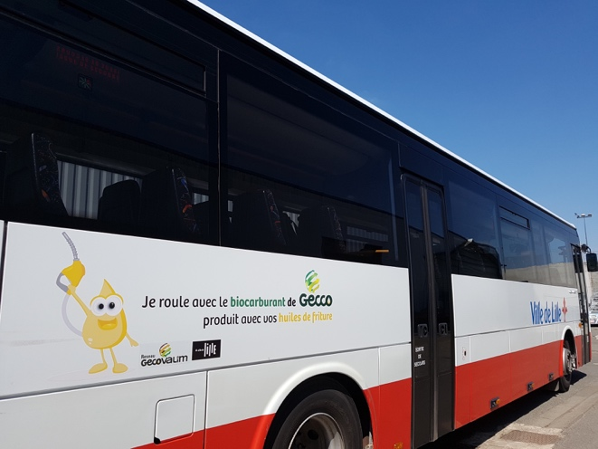
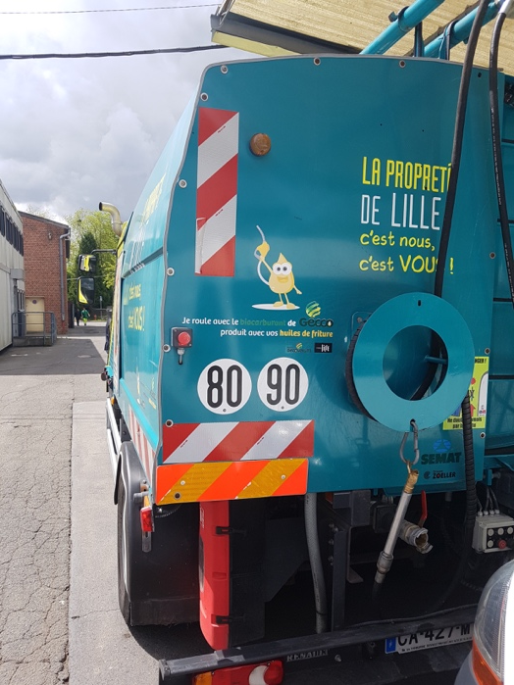

Test on City of Lille and Gecco vehicles
Test start: april 2017
Fuel: B30
(30% biodiesel + 70% gas-oil)
3 vehicles :
1 school transport bus (Euro 4)
1 city cleaning vehicule (Euro 5)
1 waste collection lorry (Euro 4)
Notes:
Stéphane puis Michel
*

Slide 13

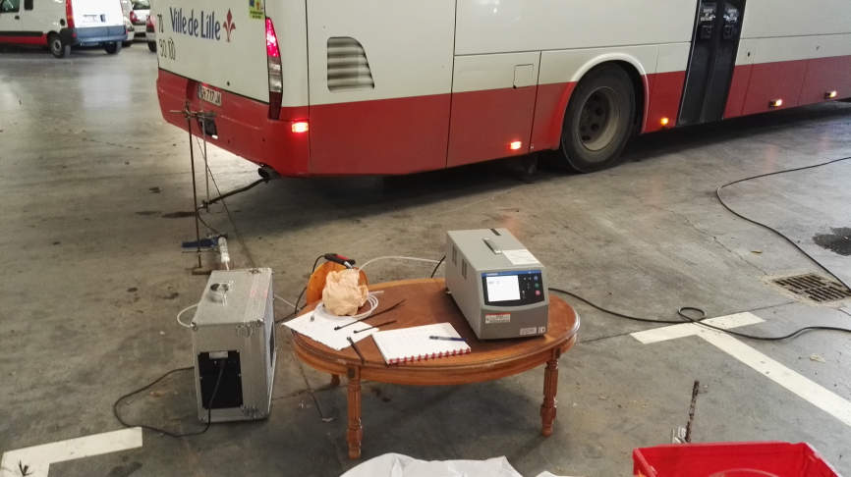
Test on vehicles - Results
Fuel consumption:
No significant impact (+2%)
Maintenance:
No technical problem
Gazole filter must be changed 1 month after switching to B30
After that no needed change in vehicle’s maintenance
Exhaust gases:
NO : +2 %
NO_{x} : + 6%
CO : -12%
CO₂ : -2%
O₂ : +2%
Particles:
To be measured in Q1 2019
- 40 % expected
Notes:
*

Slide 14



Extension of the experimentation
City of Lille:
11 vehicules in January 2019
Extension to 20 vehicles during year 2019
City of Charleville Mézières:
3 vehicles in November 2018
6 to 10 vehicles in June 2019
La Poste:
10 vehicles in November 2018
Community of Béthune-Bruay:
2 vehicles in January 2019
Notes:
*

Slide 15



Timeline
Plant set-up
+
Regulatory authorizations
Project start
Plant construction
2016
2017
2018
2019
2020
2021
Biodiesel sale starts
Demonstration
+ process improvements
Notes:
*

Slide 16
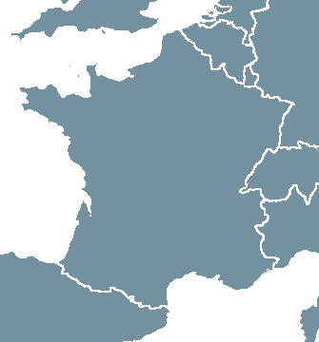




Replication in other territories
Hauts de France
Normandy
Ardennes
Île de France
Rhône Alpes Auvergne
Burgundy
Ardèche
Notes:
*

Slide 17
















Thanks for your attention – Any questions ?
Gecco
@GeccoSARL
Notes:
*

